Slide 1

PANDAS
A Python Library for Data Manipulation, Analysis & Cleaning
Fast, flexible tools for working with tabular data

Slide 2
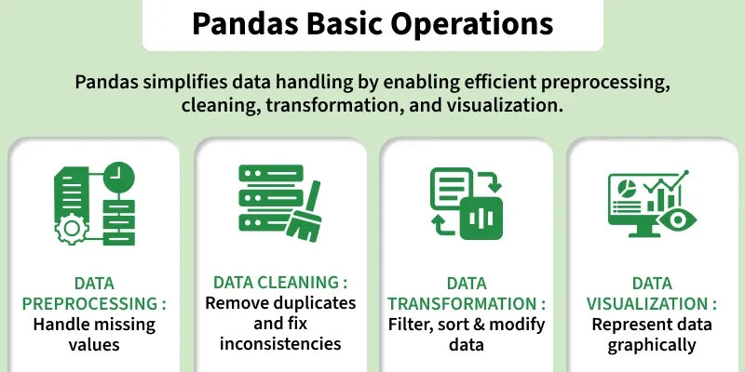
What is Pandas?
Pandas is an open-source Python library used for data manipulation, analysis, and cleaning.
It provides fast and flexible tools to work with tabular data — similar to spreadsheets or SQL tables.
Sample code — reading & inspecting a dataset
Rows × Columns
Handled in a few lines of code
Pandas allows efficient handling and analysis of structured data with minimal, readable code.

Slide 3




Part of a Powerful Ecosystem
Pandas is widely used in data science and analytics thanks to its integration with:
NumPy
Matplotlib & Seaborn
SciPy
Scikit-learn
Numerical operations
Data visualization
Statistical analysis
Machine learning workflows

Slide 4

Getting Started
Installation & import
1
Install Pandas
pip install pandas
2
Import the library
import pandas as pd
Note: “pd” is just an alias — it’s not required, but it keeps code shorter when calling methods or properties.

Slide 5

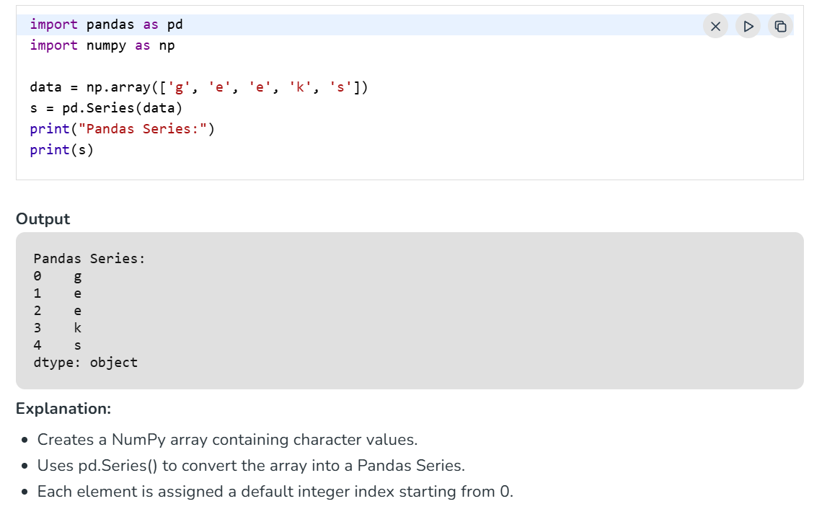
Data Structures — Series
One-dimensional labeled array
A Pandas Series is a one-dimensional labeled array capable of holding data of any type. It can be created from:
Python lists
NumPy arrays
Dictionaries
Scalar values
External files (CSV, Excel, databases)
Example: creating and printing a Series
The labels associated with a Series are called its index.

Slide 6
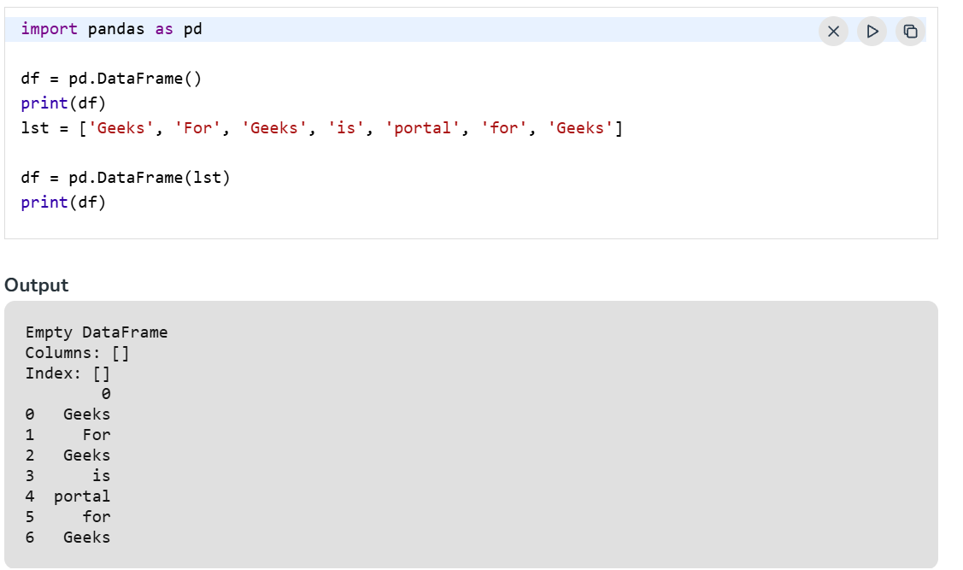
Data Structures — DataFrame
Two-dimensional labeled data structure
A DataFrame has labeled axes — rows and columns — and is Pandas' primary structure for tabular data.
Typically created by loading datasets from:
SQL databases
CSV files
Excel files
Lists, dictionaries, or a list of dictionaries
Example: building a DataFrame from a dictionary

Slide 7

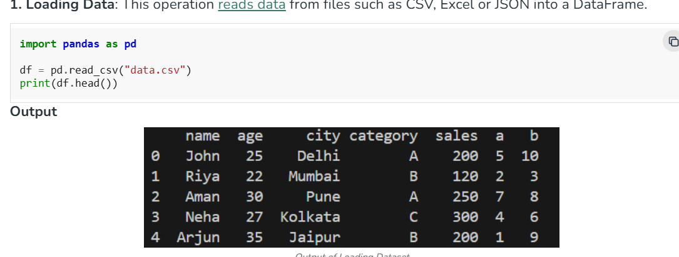

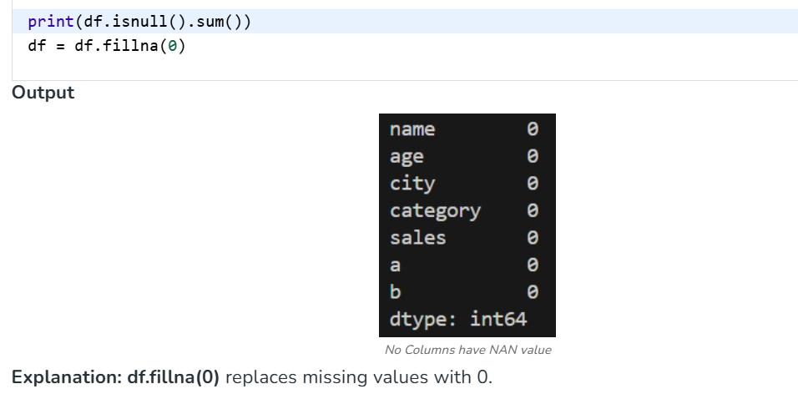

Core Operations in Pandas (1/2)
Essential functionality for working with structured data
1. Loading Data
Reads data from files such as CSV, Excel, or JSON into a DataFrame.
2. Viewing & Exploring Data
Inspect rows, summary statistics, and metadata after loading.
3. Handling Missing Data
Detect, remove, or replace empty or missing values.

Slide 8

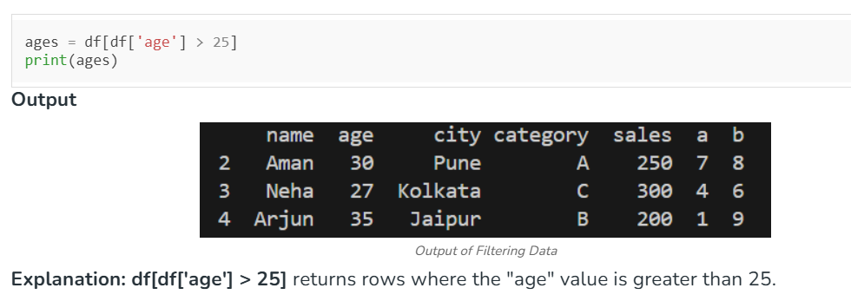

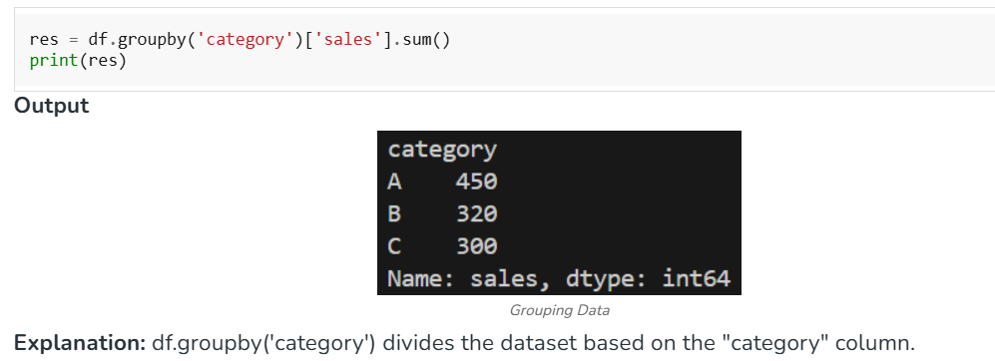

Core Operations in Pandas (2/2)
Selecting, shaping, and summarizing your data
4. Selecting & Filtering
Retrieve specific columns, rows, or records matching a condition.
5. Adding & Removing Columns
Create new columns from existing ones, or delete columns you no longer need.
6. Grouping Data (GroupBy)
Organize data into categories and compute sums, counts, or averages per group.

Slide 9

Why Pandas?
Fast, flexible, and expressive — Pandas turns messy, real-world data into clean, structured
insight in just a few lines of code.
Series & DataFrames
Load · View · Clean
Filter · Transform · Group
Built for NumPy, SciPy & scikit-learn
pip install pandas · import pandas as pd

